Slide 1
Chapter 4 Fluid Kinematics
CE30460 - Fluid Mechanics
Diogo Bolster

Slide 2
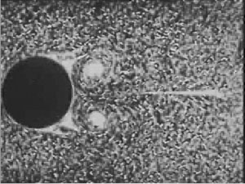
Velocity Field
How could you visualize a velocity field in a real fluid?

Slide 3
Streamlines, Steaklines and Pathlines
A streamline is a line that is everywhere tangent to the velocity field – dy/dx=v/u (governing equation)
A streakline consists of all particles in a flow that have previously passed through a common point
A pathline is the line traced out by a given particle as it flows
For a steady flow they are all the same. For an unsteady flow they are not.

Slide 4
Example
https://engineering.purdue.edu/~wassgren/applet/java/flowvis/
http://www-mdp.eng.cam.ac.uk/web/library/enginfo/aerothermal_dvd_only/aero/fprops/cvanalysis/node8.html
Look at these yourself – we will demonstrate an example using Matlab in a few slides.

Slide 5
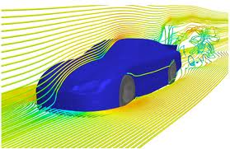
Streamlines
Streamlines around a Nascar

Slide 6
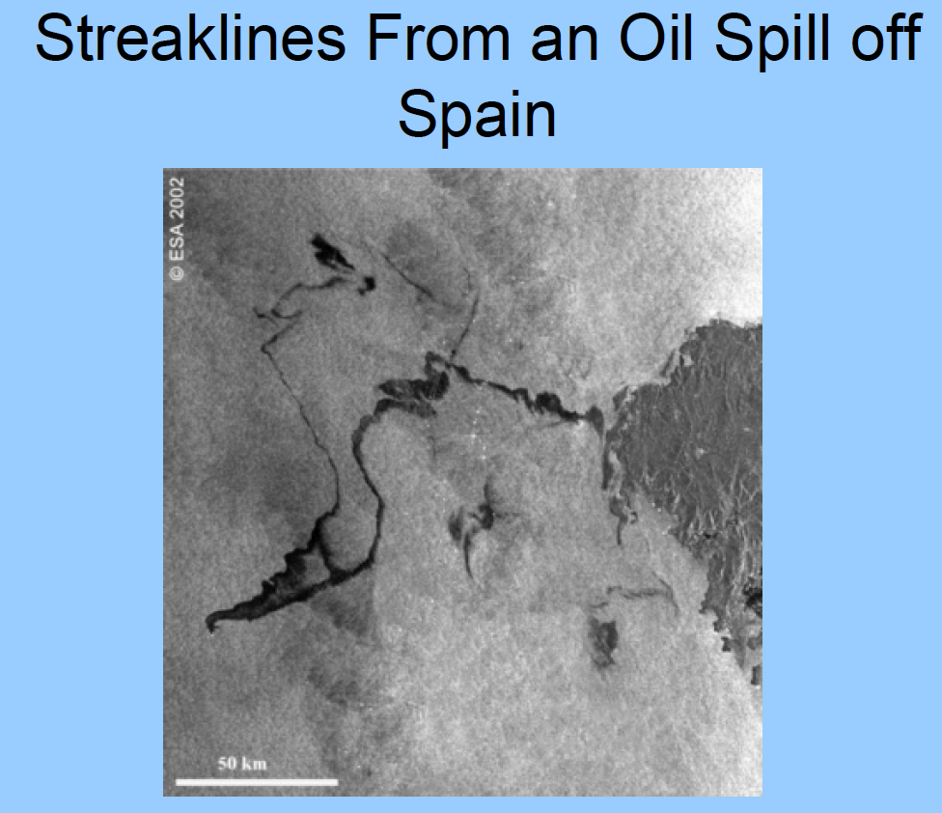
Streaklines

Slide 7
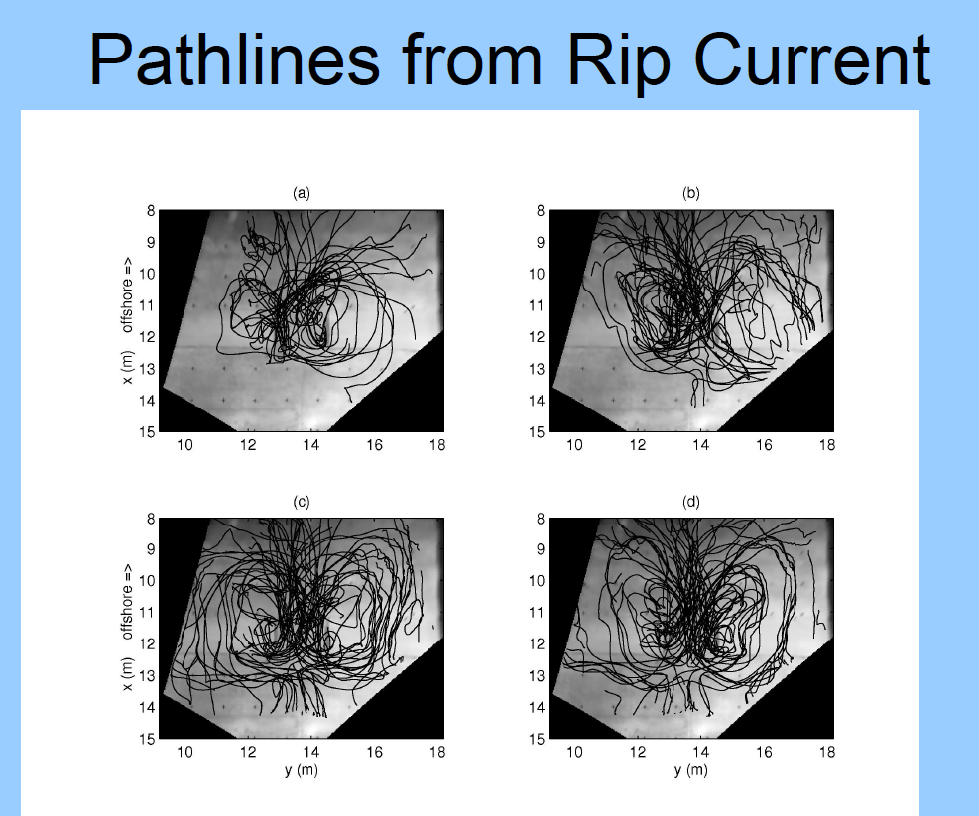
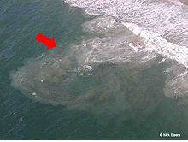
Pathlines

Slide 8
Example Problem
Flow Above an Oscillating Plate with a vertical blowing is given by
Draw the streamlines at various times
Draw pathlines
Draw streaklines
Compare to the steady case where
See Matlab code

Slide 9
Eulerian vs. Lagrangian Perpsective
Eulerian
Sit and observe a fixed area from a fixed point
Lagrangian
Travel with the flow and observe what happens around you
Mixed – something that sits between the two

Slide 10
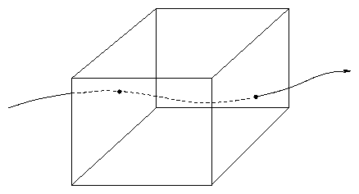
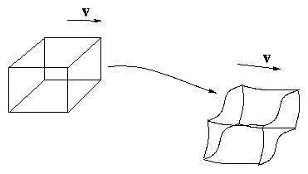
Eulerian vs. Lagrangian Perpsective

Slide 11
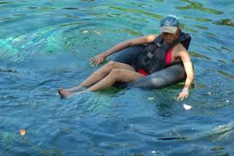

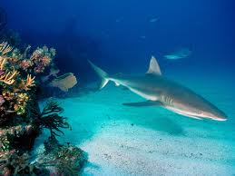
Eulerian vs. Lagrangian Perpsective – Which is which?

Slide 12
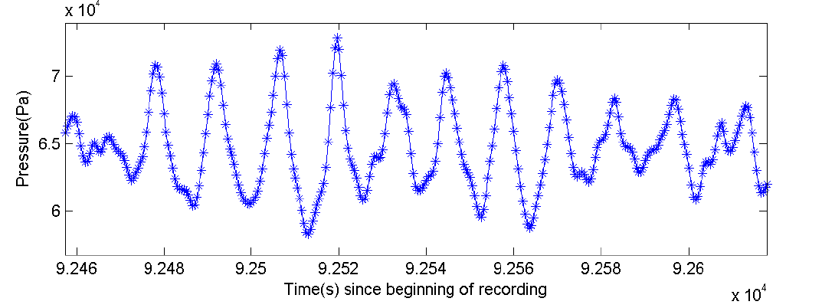
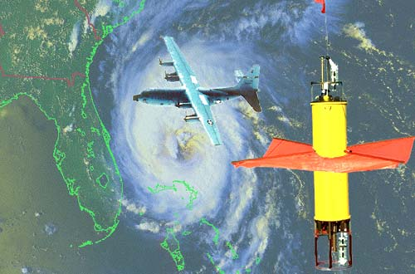
Experimental Measurements
Fixed Measurement System
A floating gauge

Slide 13
The Material Derivative
Consider a fluid particle moving along its pathline (Lagrangian system)
The velocity of the particle is given by
It depends on the x,y, and z position of the particle
Acceleration
a_{A}=dV_{A}/dt
It is tough to calculate this, but if we have an Eulerian picture……

Slide 14
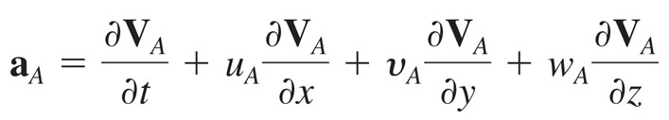
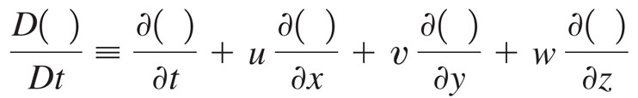
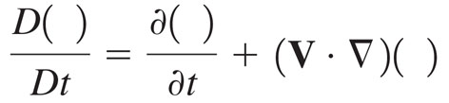
The Material Derivative
The material derivative (you can see it called the substantial derivative too) relates Lagrangian and Eulerian viewpoints and is defined as
Or in compact notation

Slide 15
The Material Derivative
Unsteady local
Time derivative
Convective Effects
Example – convection of heat or a contaminant….

Slide 16
Control Volumes
A system is a collection of matter of fixed identity (always the same packets)
A Control Volume (CV) is a volume in space through which fluid can flow (it can be Lagrangian, i.e. moving and deforming with flow or Eulerian, i.e. fixed in space)
CVs can be fixed, mobile, flexible, etc.
All laws in continuum mechanics depart from a CV analysis (i.e. balance mass, momentum, energy etc in a sufficiently small control volume).

Slide 17
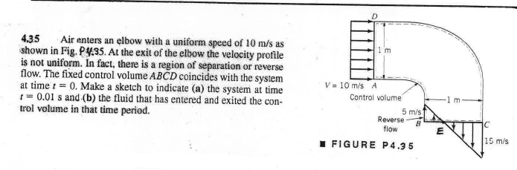
Sample Problem to distinguish System from Control Volume

Slide 18
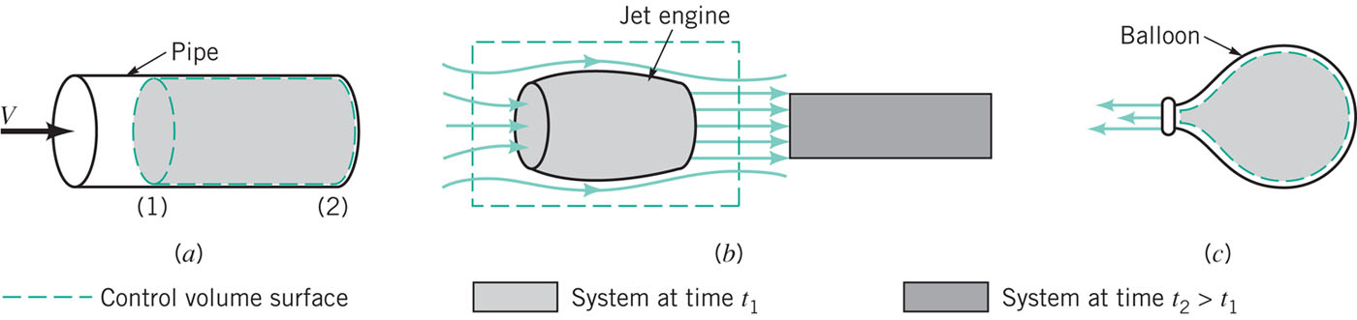
Control Volumes

Slide 19

Reynolds Transport Theorem
A tool to relate system concepts to control volume concepts
Let B be a fluid parameter (e.g. mass, temperature, momentum)
Let b represent the amount of that parameter per unit mass
e.g. Momentum B=mV => b=V
Energy B=1/2mV² => b=1/2 V²

Slide 20
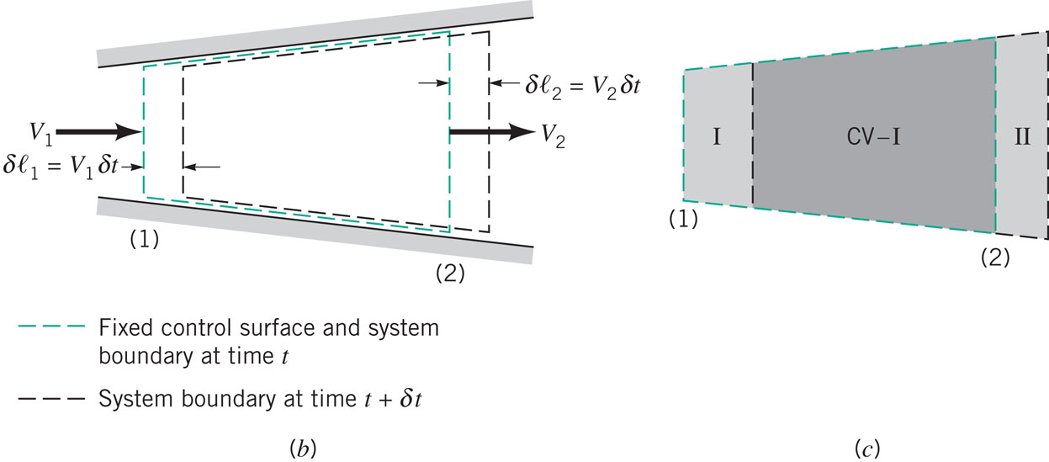
Reynolds Transport Theorem

Slide 21
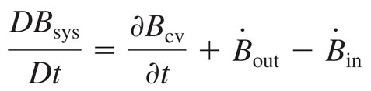
Reynolds Transport Theorem
Generally written as

Slide 22
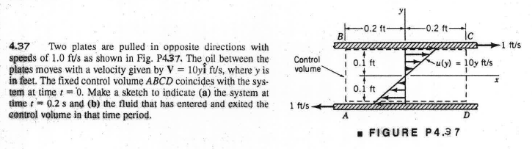
Sample Problem

Slide 23
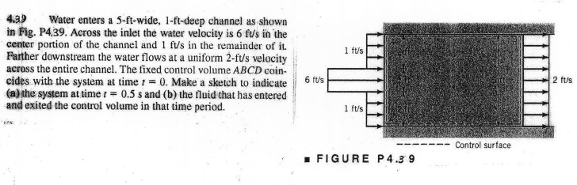
Sample Problem

